Slide 1

Community Service Search
Deb Banerji, Mihir Parshionikar, Steven Hsieh

Slide 2
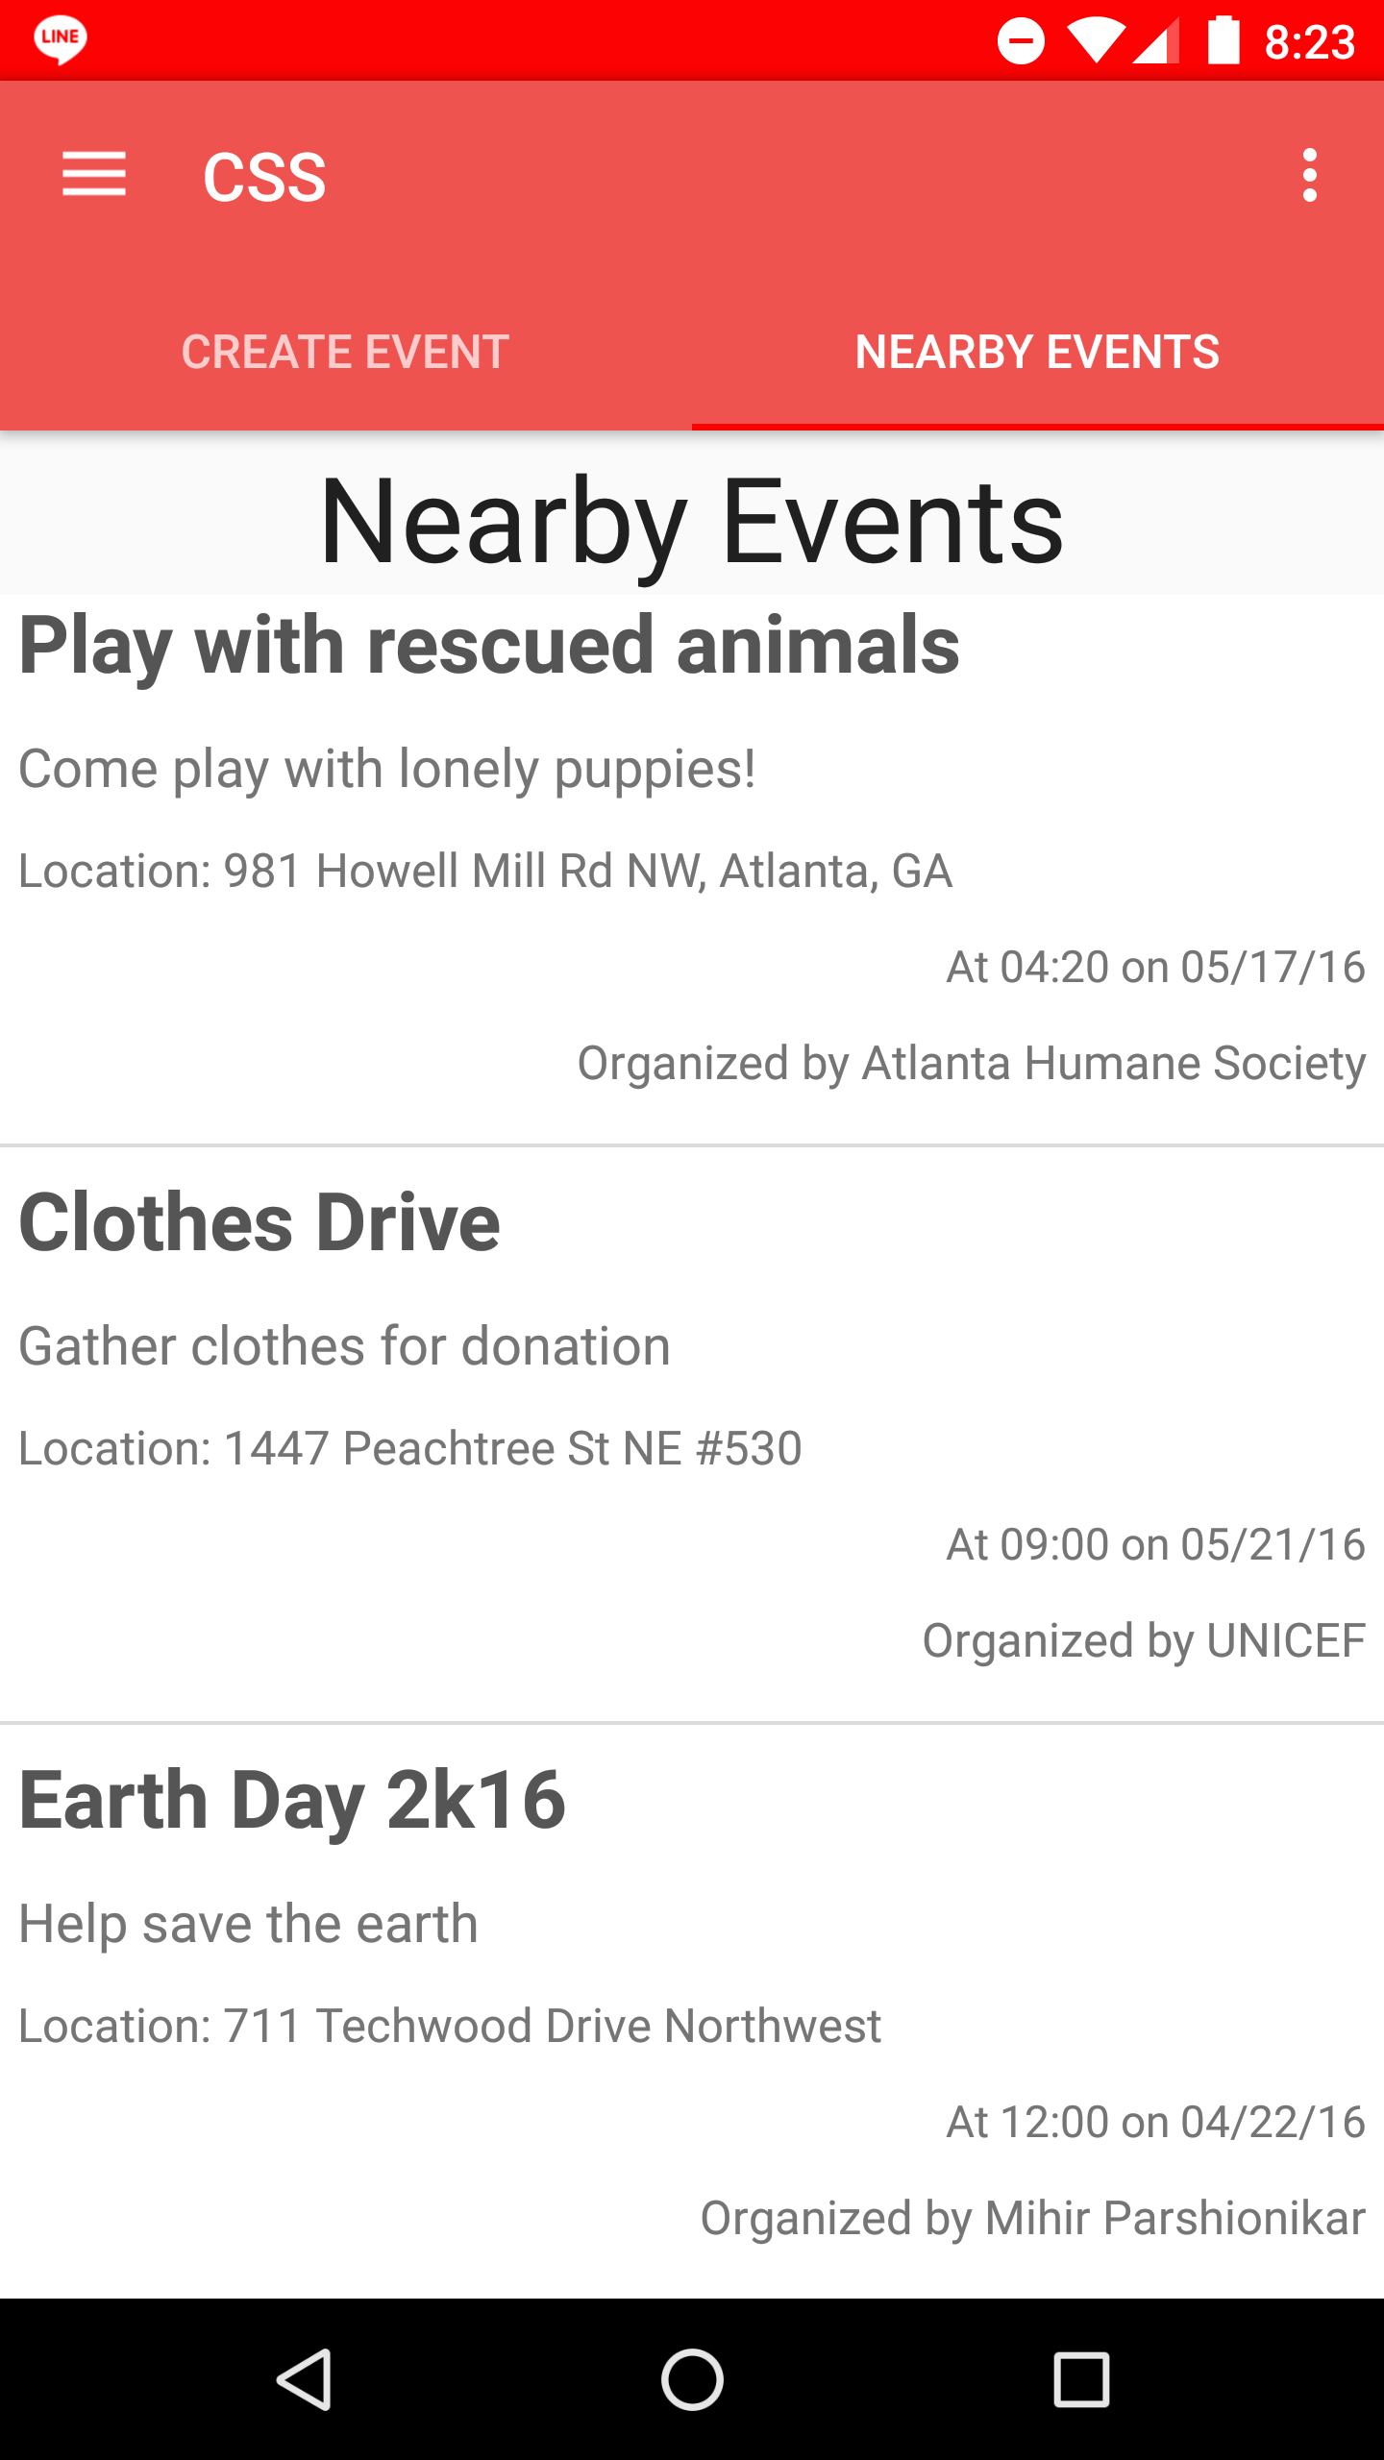

Community service at your fingertips.

Slide 3
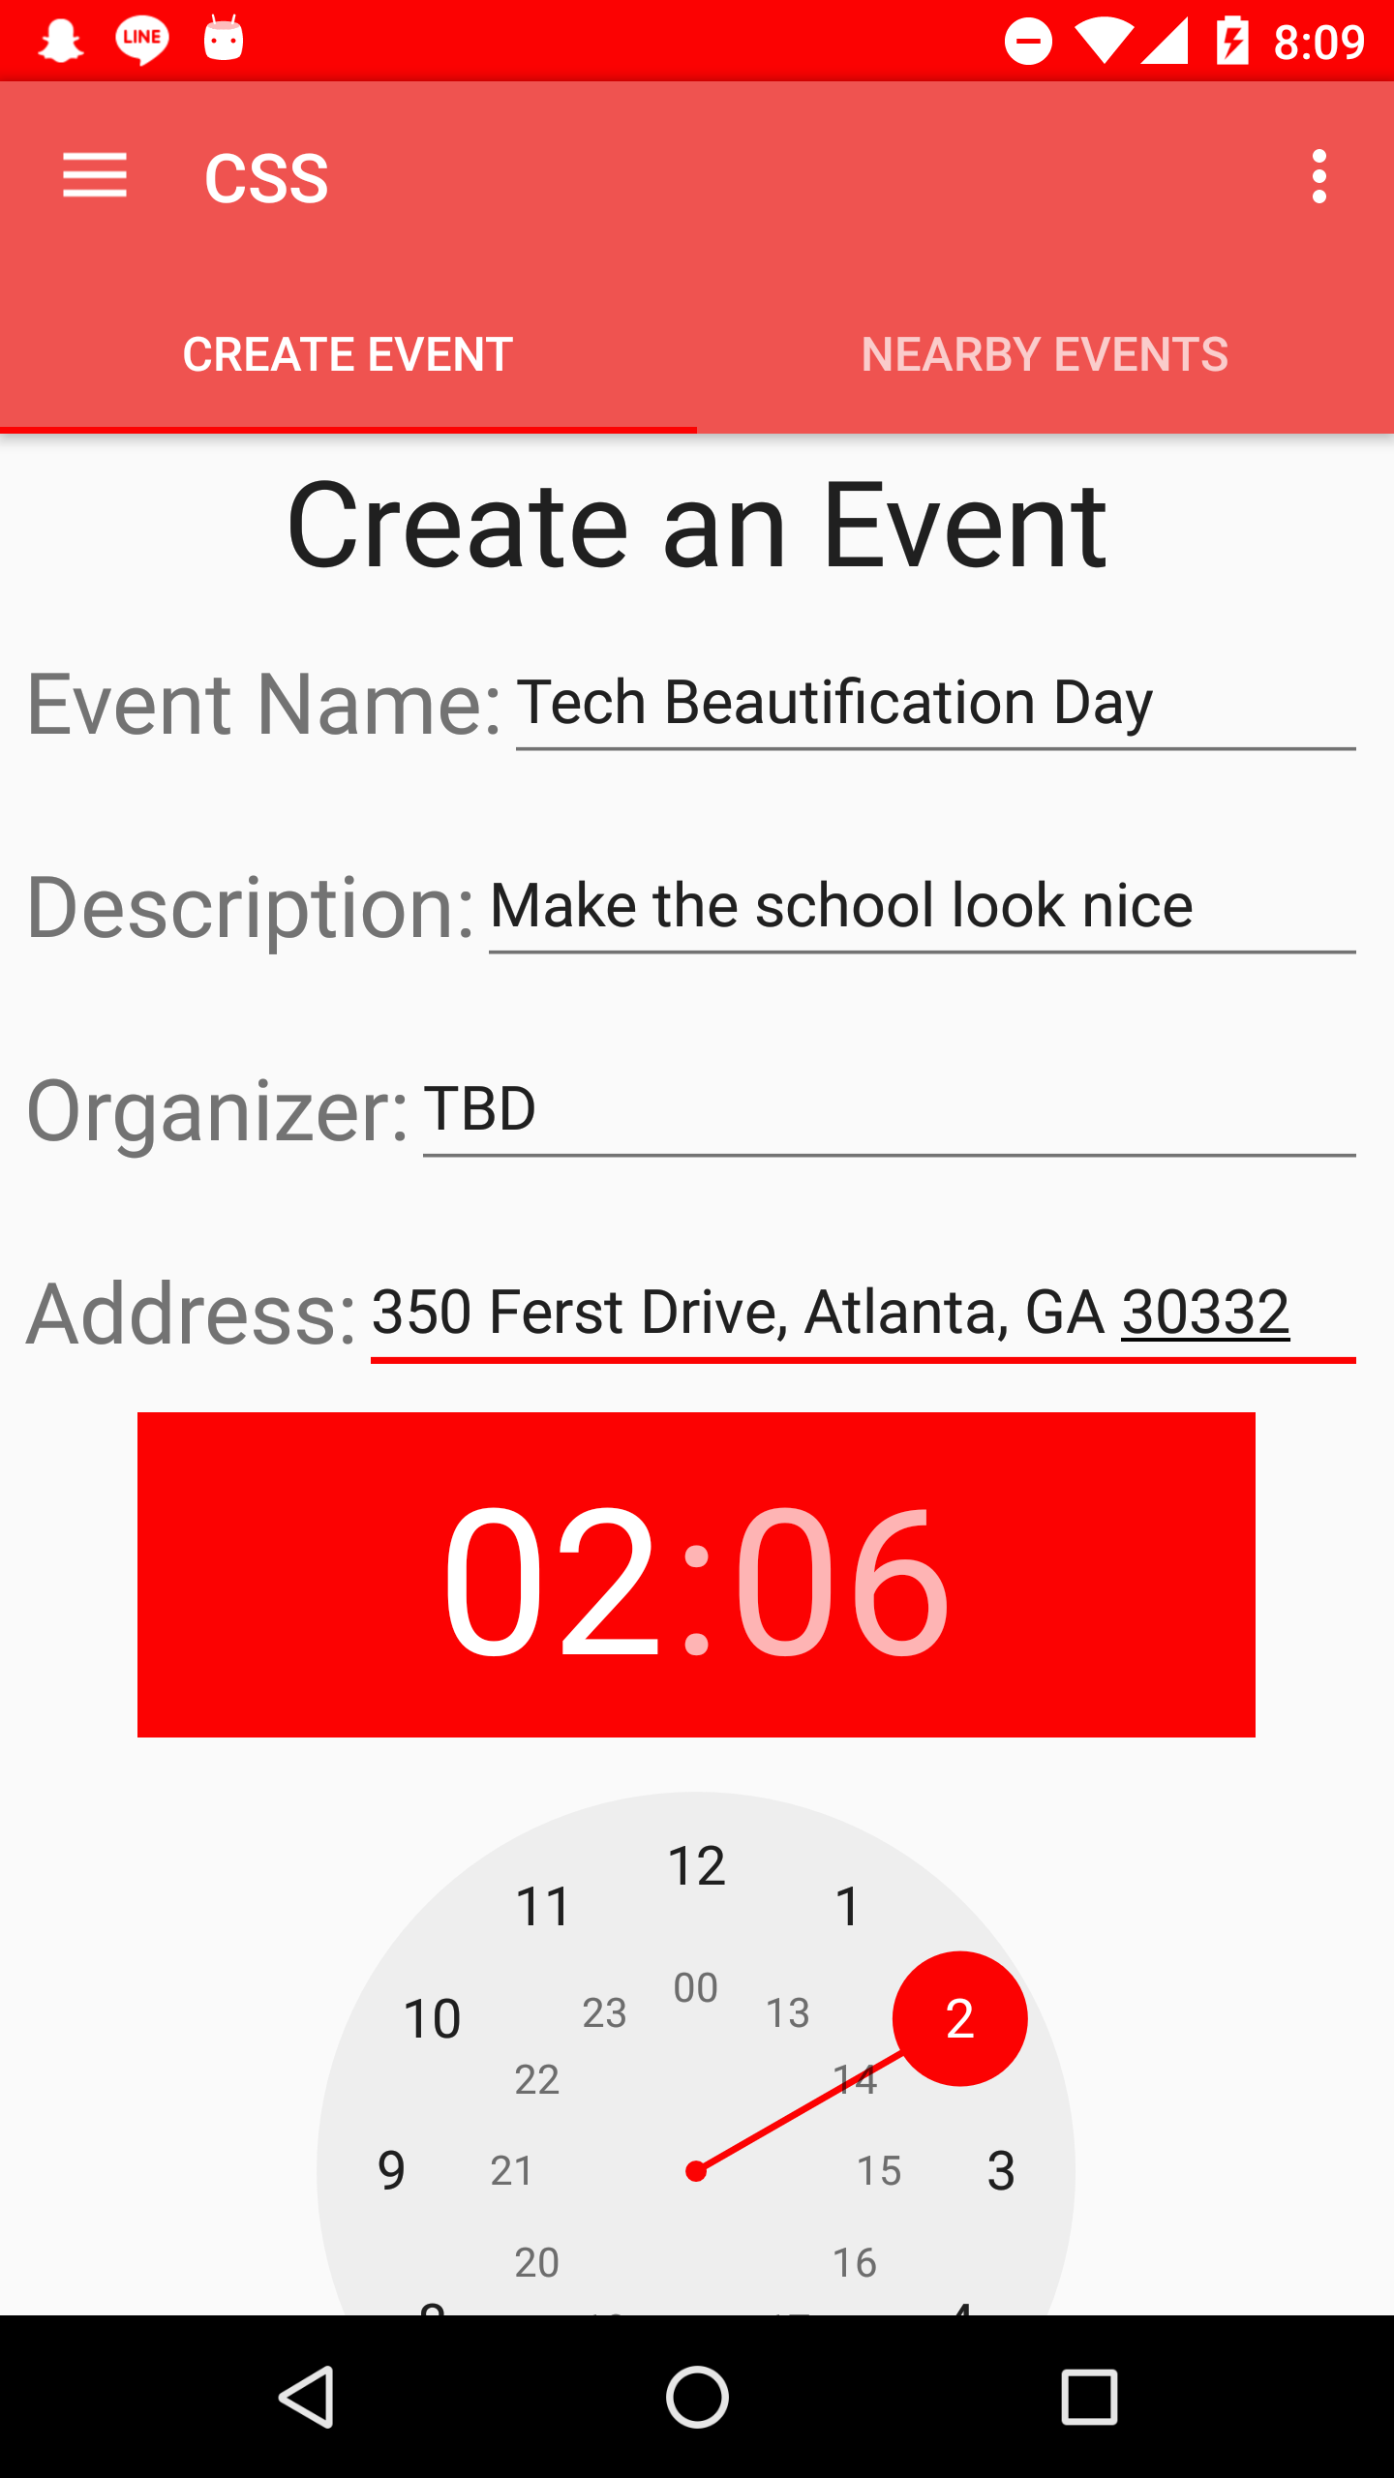
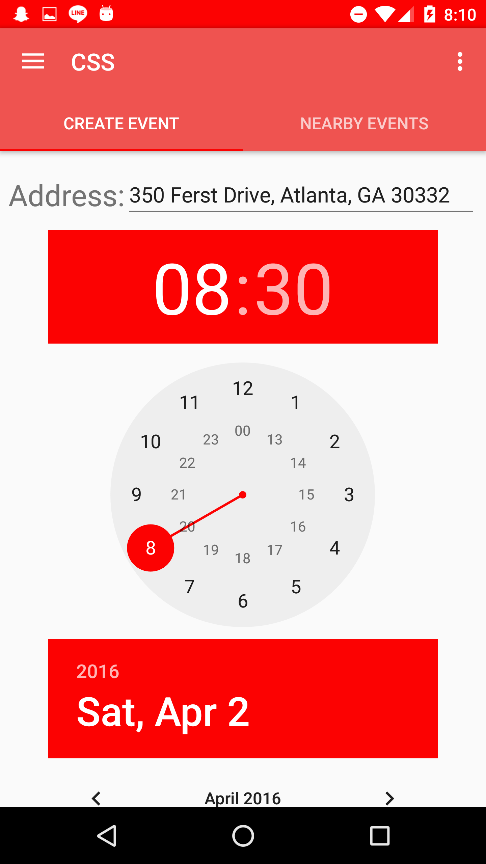

Organize events with ease.
Simplified date and time pickers for intuitive feel
Make logistical information part of your event

Slide 4
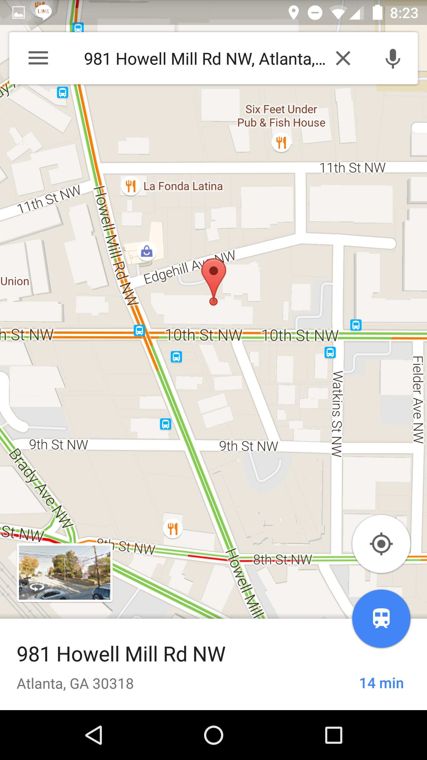
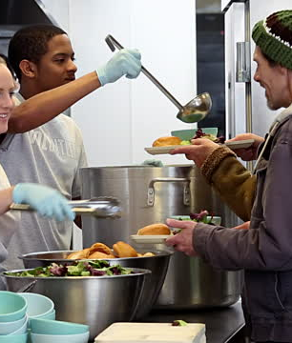
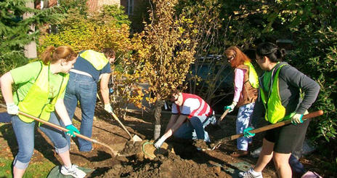
Become part of your community again.
Full Google Maps integration to find events

Slide 5
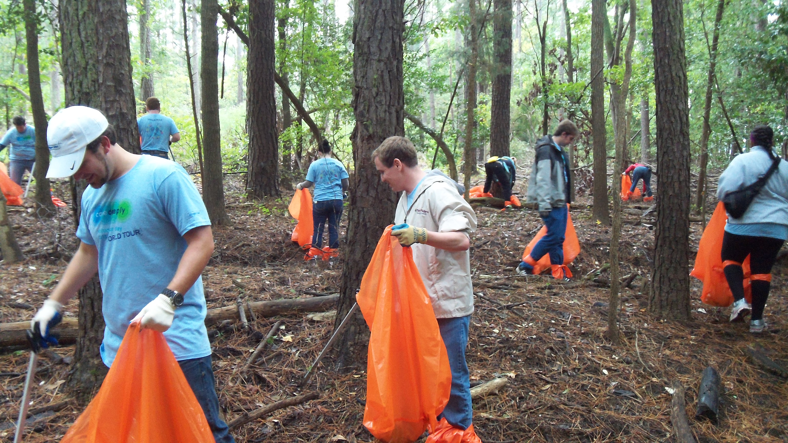
Helping you to give back

